Slide 1
Employee Data Analysis using Excel
STUDENT NAME: SWATHI P.V
REGISTER NO: 122204068
DEPARTMENT: B.COM (CS)
COLLEGE: SHRI KRISHNASWAMY COLLEGE FOR WOMEN

Slide 2
PROJECT TITLE
Employee Gender Analysis using Excel

Slide 3


AGENDA
Problem Statement
Project Overview
End Users
Our Solution and Proposition
Dataset Description
Modelling Approach
Results and Discussion
Conclusion
3/21/2024 Annual Review

Slide 4

PROBLEM STATEMENT
Glass Ceiling: Women and non-binary individuals face barriers to promotion and leadership positions.
Sexual Harassment: Inadequate policies and procedures fail to prevent and address sexual harassment, creating a hostile work environment.
Lack of Support for Working Parents: Insufficient family leave policies, childcare support, and flexible work arrangements disproportionately affect women and caregivers.
Unconscious Bias in Hiring: Recruitment processes and criteria perpetuate gender biases, affecting hiring decisions.
Gender Bias: The company's policies, practices, and culture perpetuate gender-based discrimination, affecting employee experiences and career advancement.
Lack of Diversity: Insufficient representation of diverse genders in leadership positions, teams, and hiring processes hinders innovation and company performance.
Inequitable Work Environment: Gender disparities in workload, opportunities, and resources hinder employee satisfaction, engagement, and well-being.

Slide 5

PROJECT OVERVIEW
Diversity and inclusion strategies
Equal employment opportunities (EEO)
Pay equity and fairness
Promoting women in leadership
LGBTQ+ inclusivity
Family leave policies
Gender-sensitive workplace culture
.

Slide 6

WHO ARE THE END USERS?
Employees
Customers
Client-facing team
IT and technical teams
Management and leadership
Remote workers

Slide 7

OUR SOLUTION AND ITS VALUE PROPOSITION
filter-remove
pivot- summary
graph data visualization
Transformative Initiatives: Implement diversity, equity, and inclusion training, mentorship programs, and policy reforms to address gender biases, pay gaps, and representation disparities.
Accountability and Metrics: Establish key performance indicators (KPIs), regular audits, and leadership accountability to track progress, measure impact, and ensure sustained commitment to gender equality.

Slide 8
Dataset Description
🔹Employee = kaggle
🔹 Nine Feature
🔹 Employee I'd
🔹 Name = text
🔹 Data = number
🔹 Employee type
🔹 Performance level
🔹 Gender
🔹 Female and male
🔹 employee rating numerical

Slide 9

THE "WOW" IN OUR SOLUTION
AI-powered bias detection and mitigation tools
Personalized mentorship and career development platforms
Inclusive language and communication guidelines.
Anonymous feedback and incident reporting systems
Gamified diversity and inclusion training.
3/21/2024 Annual Review
9

Slide 10
MODELLING
DATA COLLECTION:
IN edunet dash board downloading the data sets while using the kaggle
FEATURE:
Identifying the employee ID
Identifying employee names
Identifying employee performance
Identifying employee gender
DATA CLEANING:
1) To find the missing value
2 ) To the filtering the missing value
GENDER ANALYSIS:
Pivot table
Separating the gender
Graph
Filter remove
Pivot summary
Data visualization
10

Slide 11
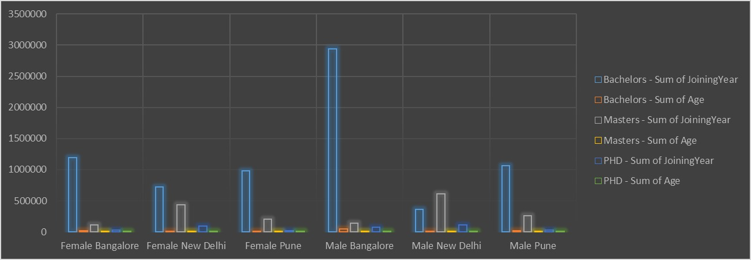
RESULTS
11

Slide 12
conclusion
Gender equality in the workplace is a critical driver of business success, employee well-being, and social progress. By acknowledging and addressing systemic gender biases, companies can foster inclusive cultures, improve diversity, and enhance performance.

